Slide 1
MYTHS and LEGENDS -
the unifying element of European culture

Slide 2
St. John of Nepomuk
(Svatý Jan Nepomucký)
Author: Andrea Hejzlarová, Gymmnázium J. Jungmanna, Litoměřice

Slide 3
Content
1. John of Nepomuk
1.1 Who was he?
1.2 How do we call him?
1.3 Life
2. What happened?
2.1 Beginning
2.2. Torture
2.3. Death
2.4 Canonization
2.5 Attributes
2.6 How do we see him now?
3. John in the world

Slide 4
Who was he?

Slide 5
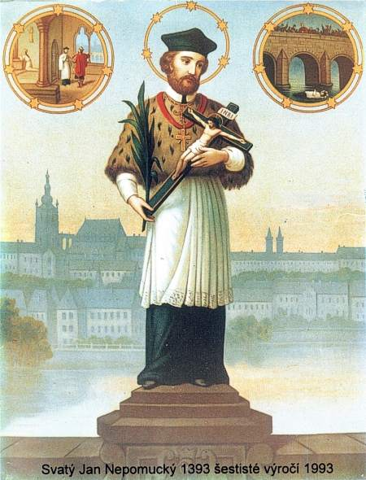
1.1 Who was he?
the confessor of the queen of Bohemia
general vicar of Prague archbishopric
the canon of Saint Giles

Slide 6
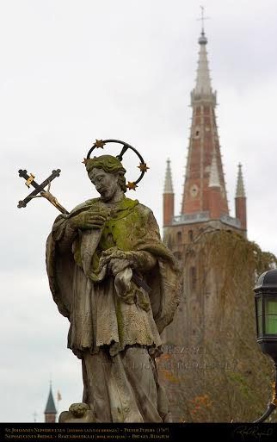
1.2 How do we call him?
Czech – Jan Nepomucký
English – John of Nepomuk
Italian - San Giovanni Nepomuceno
Portuguese - João Nepomuceno
German - Johannes von Nepomuk
Latin - Johannes Nepomucenus

Slide 7
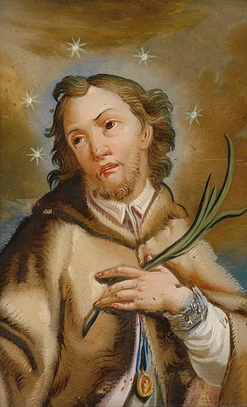
1.3 Life
* c.1345 in Nepomuk
1369 notary in Prague
1380 parson of the church
Study of canon law in Prague (bachelor's degree)
1383-87 study of canon law (Padua)
1393 general vicar
(of Prague archbishopric)
† 1393

Slide 8
What happened?

Slide 9
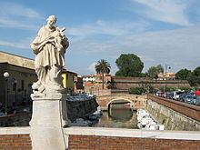
2.1Beginning
Problems between king Wenceslas IV & archbishop Jan of Jenštejn
John – was close to Jan of Jenštejn
2 popes The first – Rome The second - Avignon
Establishment of the new bishopric
March 20, 1393 the king captured 4 persons

Slide 10
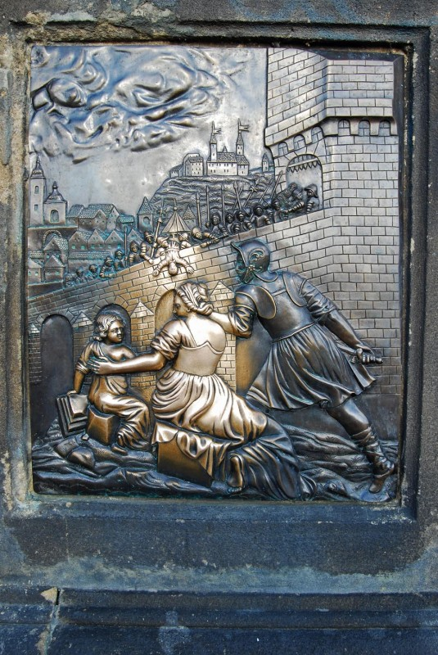
2.2 Torture
John N. was tortured
He refused to tell the queen‘s secrets

Slide 11
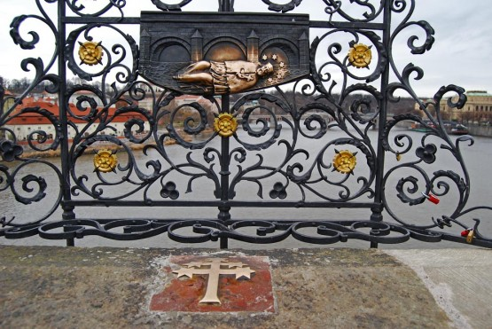
2.3 Death
He died during the torture
His body was thrown into the river Vltava

Slide 12
His tomb in Saint Vitus Cathedral

Slide 13
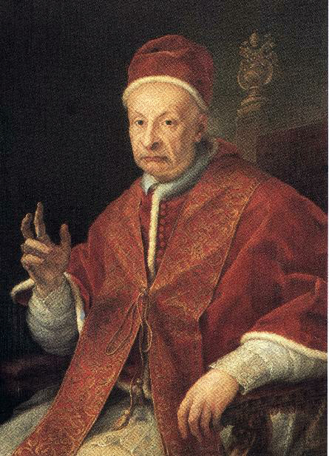
2.4 Canonization
1719 – Exhumation, his tongue was found
March 19, 1729 by pope Benedict XIII

Slide 14
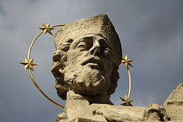
2.5 Attributes
Discovery of alleged tongue
5 stars around his head
Finger over his mouth

Slide 15
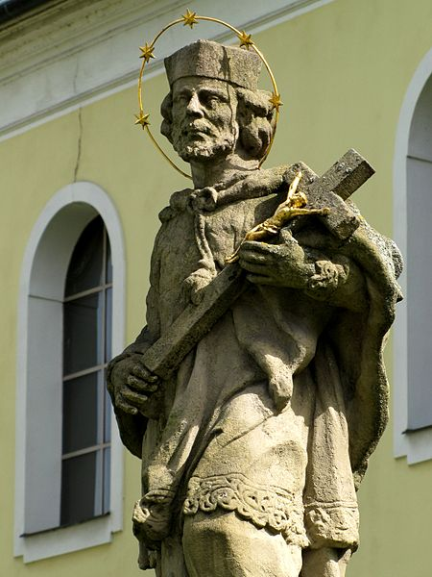
2.6 How do we see him now?
a patron saint of Czechs
a patron against calumnies
a protector from floods and drowning
the first martyr of the Seal of the Confessional
More than 33,000 his statues in Europe

Slide 16
3. John in the world
Charles Bridge, Prague
(Czech Republic)

Slide 17
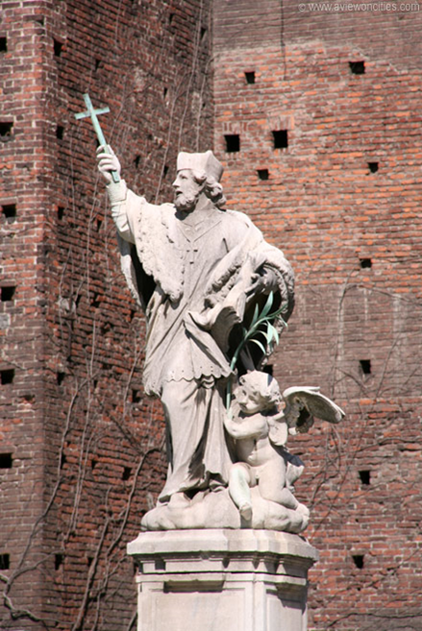
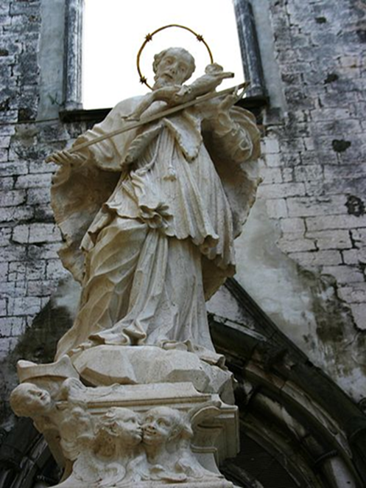
3. John in the world
Castello Sforzesco,
Milan (Italy)
Convento do Carmo, Lisbon (Portugal)

Slide 18
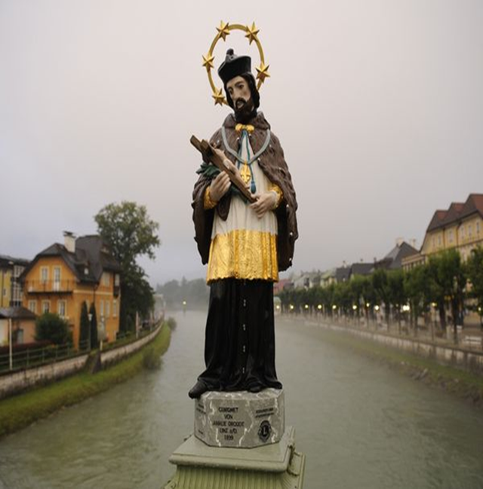
3. John in the world
Bruges, (Belgium)

Slide 19
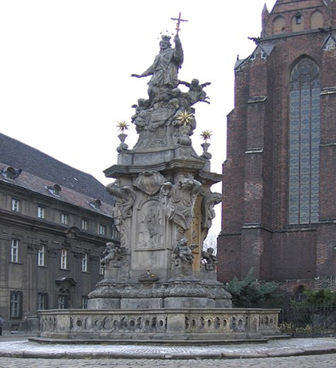
3. John in the world
Germany
Poland

Slide 20
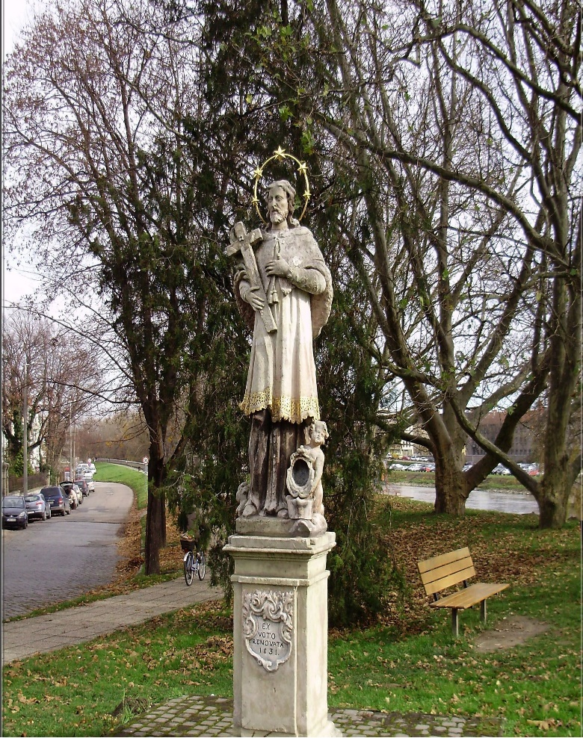
3. John in the world
Italy
Hungary

Slide 21
Resources
Information
https://www.youtube.com/watch?v=LZk_MPW44QA
http://www.fotopraha.com/jan-nepomucky.html
http://cs.wikipedia.org/wiki/Jan_Nepomuck%C3%BD#Legenda
http://www.sjn.cz/vypis.php?rubrika=187
http://en.wikipedia.org/wiki/John_of_Nepomuk
http://catholica.cz/?id=2382
Pictures
http://images.fineartamerica.com/images-medium-large/charles-bridge-statue-of-st-john-of-nepomuk---jon-berghoff.jpg
http://images.nationalgeographic.com/wpf/media-live/photos/000/226/cache/austria-lake-country-barge-saint_22686_600x450.jpg
http://photos.wikimapia.org/p/00/03/84/16/63_big.jpg
http://upload.wikimedia.org/wikipedia/commons/2/21/Statue_of_Saint_John_of_Nepomuk_-_Alte_Mainbr%C3%BCcke,_W%C3%BCrzburg_-_DSC02936.JPG
http://upload.wikimedia.org/wikipedia/commons/thumb/7/77/Johannes_von_Nepomuk_Hinterglasbild.jpg/220px-Johannes_von_Nepomuk_Hinterglasbild.jpg
http://en.wikipedia.org/wiki/File:Wroclaw_OstrowTunski-swJanNepomucen.jpg
http://www.abcsvatych.com/images/j/jan_nepomucky.jpg
http://www.sjn.cz/images2/sv_jan01.jpg
http://www.fototuristika.cz/data/wysiwyg/tips/425/image/sv.Jan_Nepomuck%C3%BD_(5).jpg
http://commons.wikimedia.org/wiki/File:John_of_Nepomuk2.jpg
http://upload.wikimedia.org/wikipedia/commons/thumb/c/c2/Jan_Nepomucky_Vizovice_02.jpg/220px-Jan_Nepomucky_Vizovice_02.jpg
http://upload.wikimedia.org/wikipedia/commons/f/fa/Benedict_XIII.jpg

Slide 22
Thank you for your attention ☺

